Slide 1
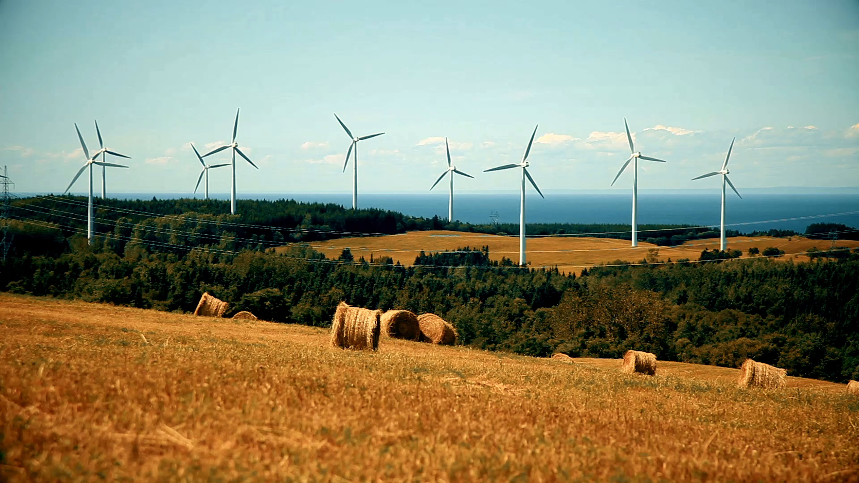
Energy situation and strategy in Italy
An overview of the 2023 national energy plan

Slide 2
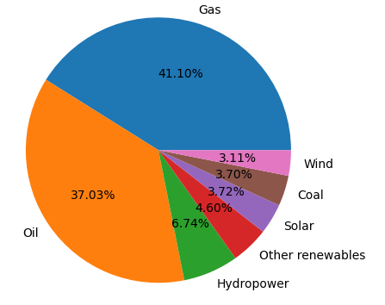
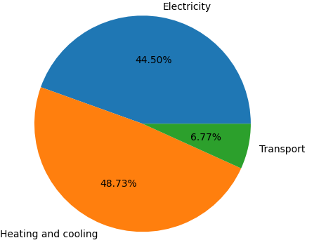
Italy energy mix in 2021

Slide 3
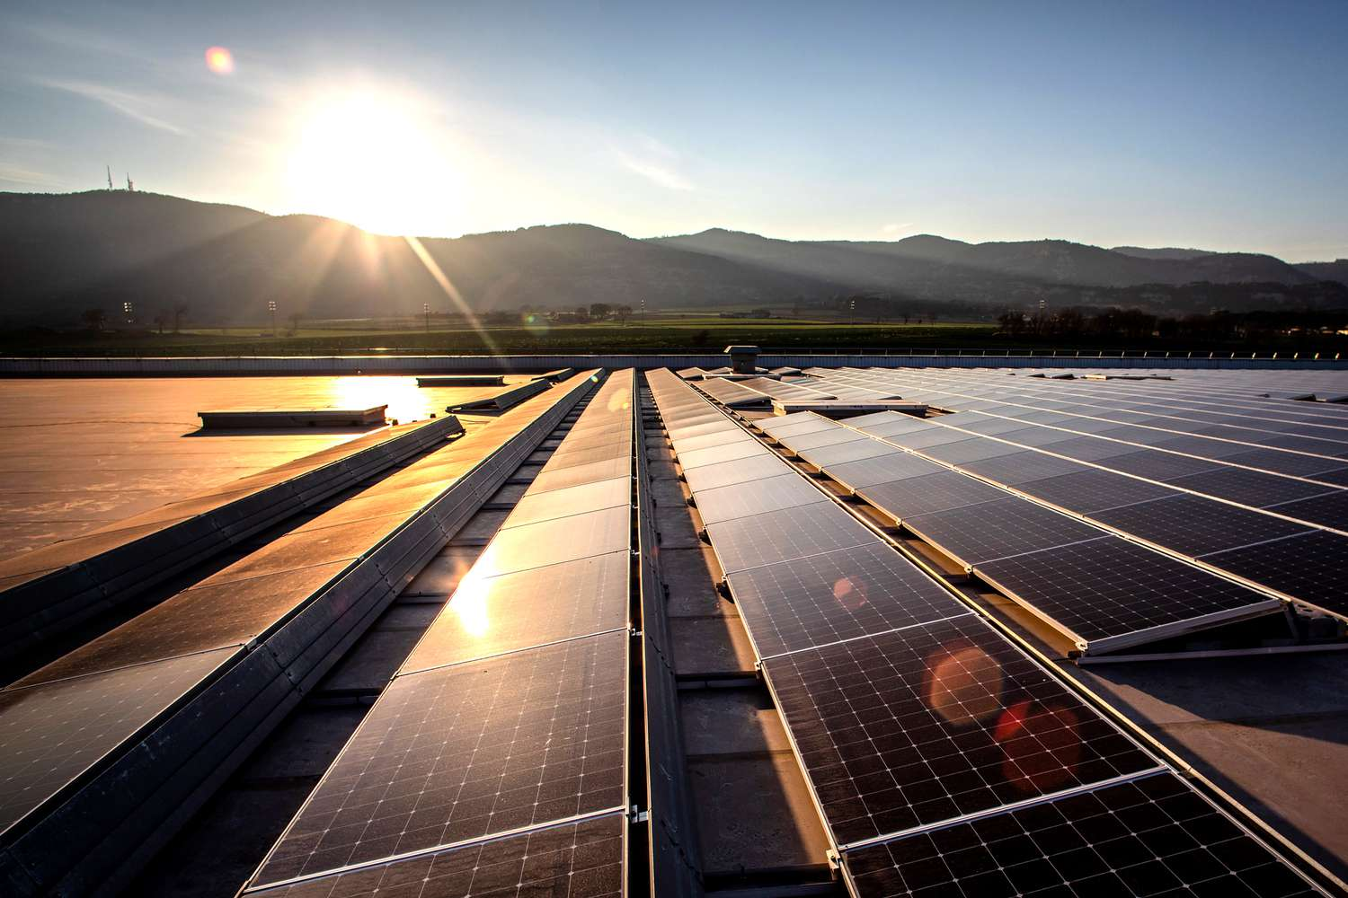
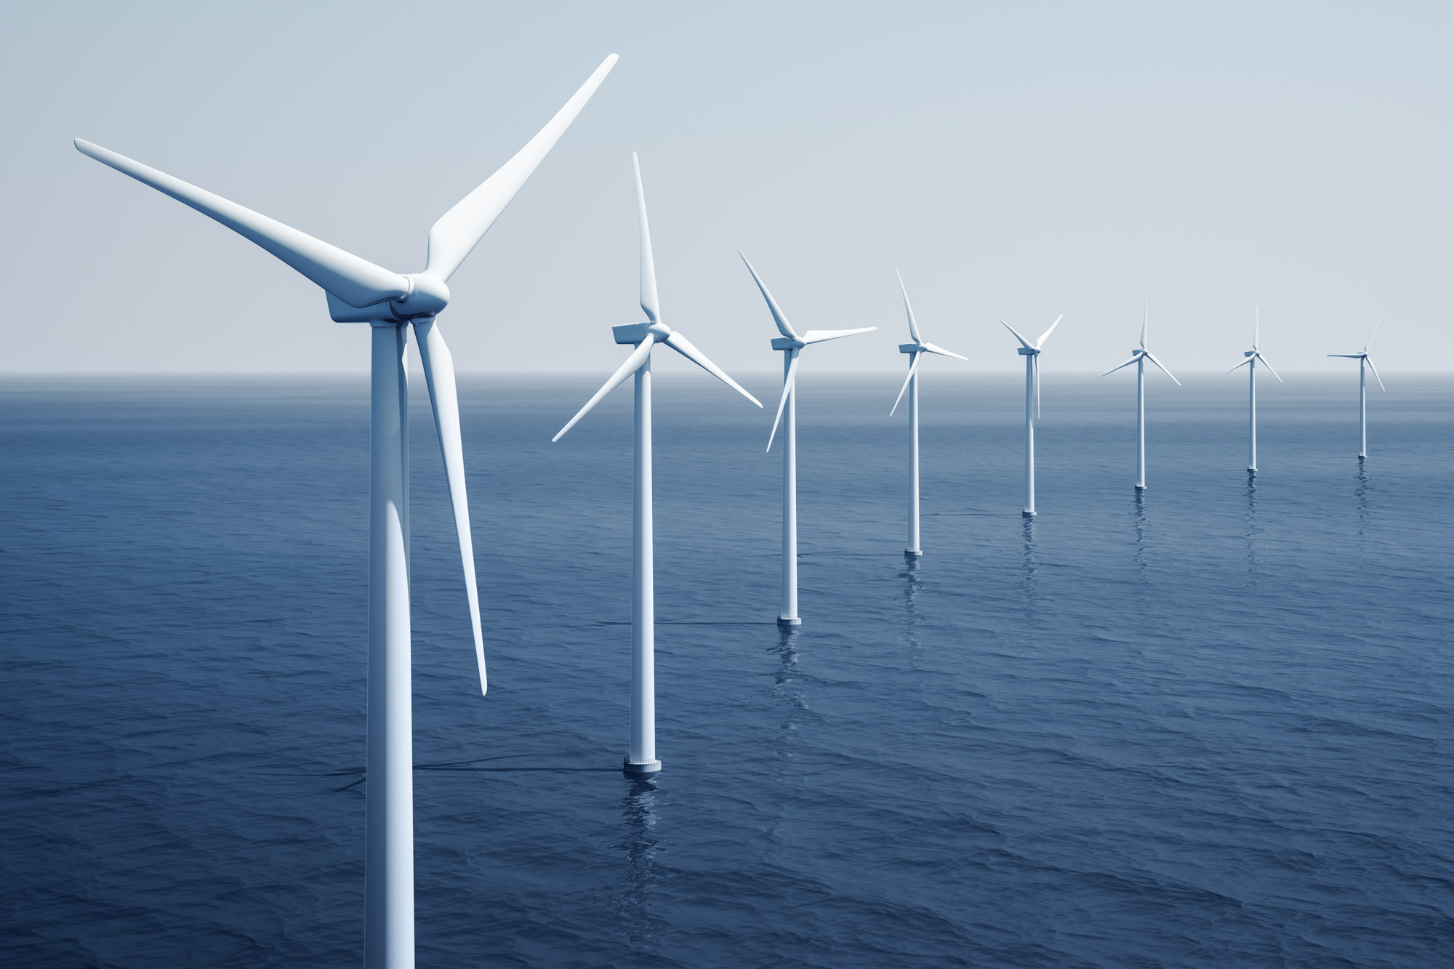
Renewable energy for electricity production

Slide 4
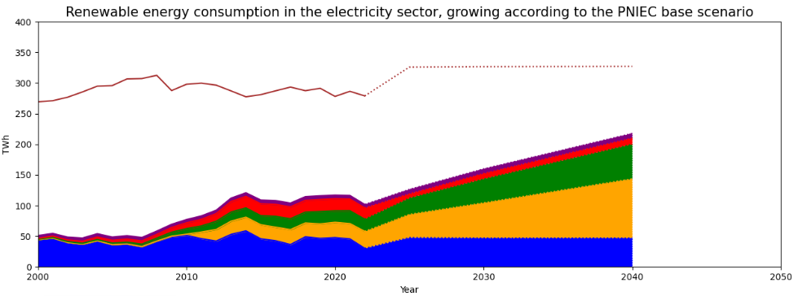
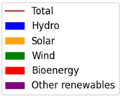
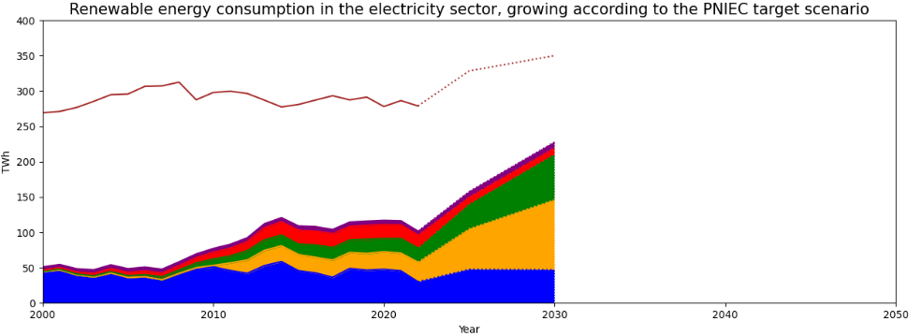
Renewable energy for electricity production
Baseline scenario
Target scenario

Slide 5
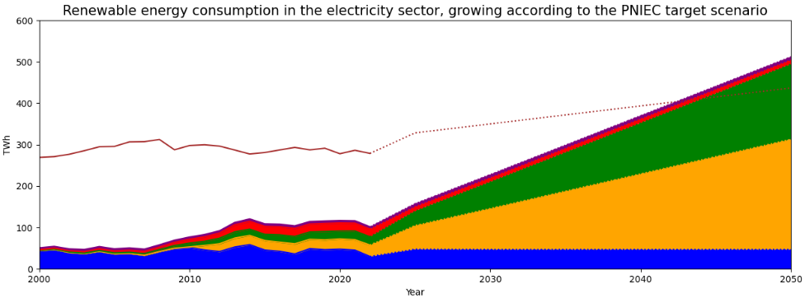
Renewable energy for electricity production
Projection to 2050

Slide 6


Renewable energy for heating and cooling

Slide 7

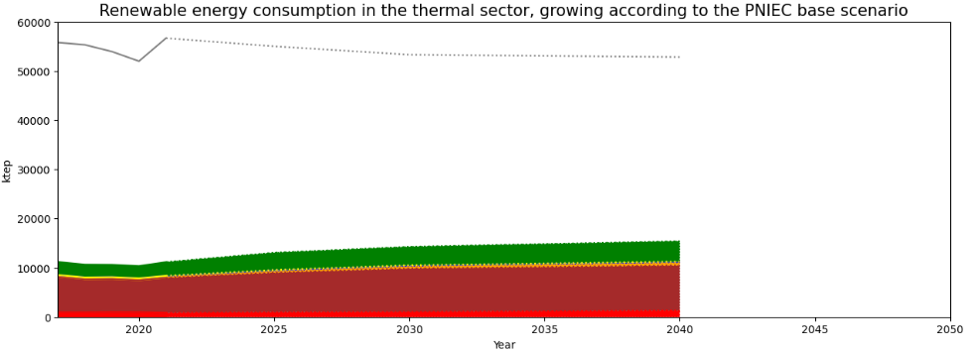
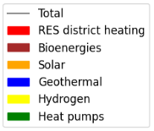
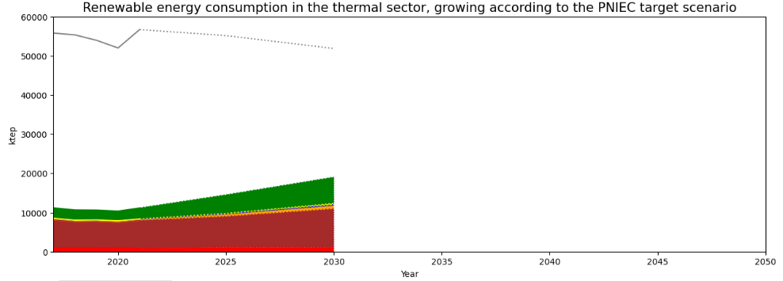
Renewable energy for heating and cooling
Baseline scenario
Target scenario

Slide 8
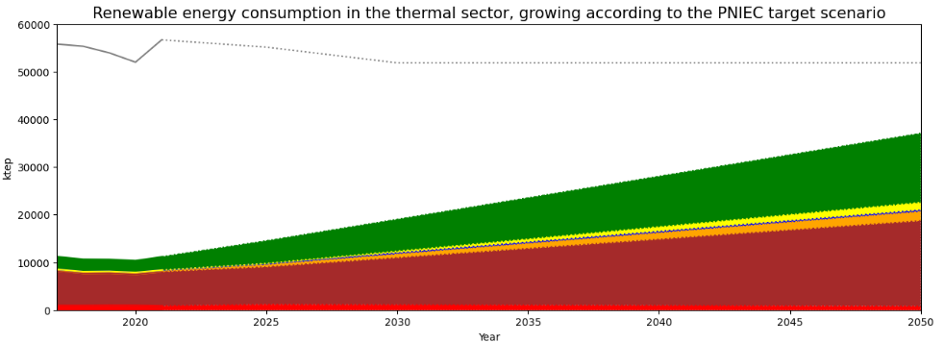
Renewable energy for heating and cooling
Projection to 2050

Slide 9

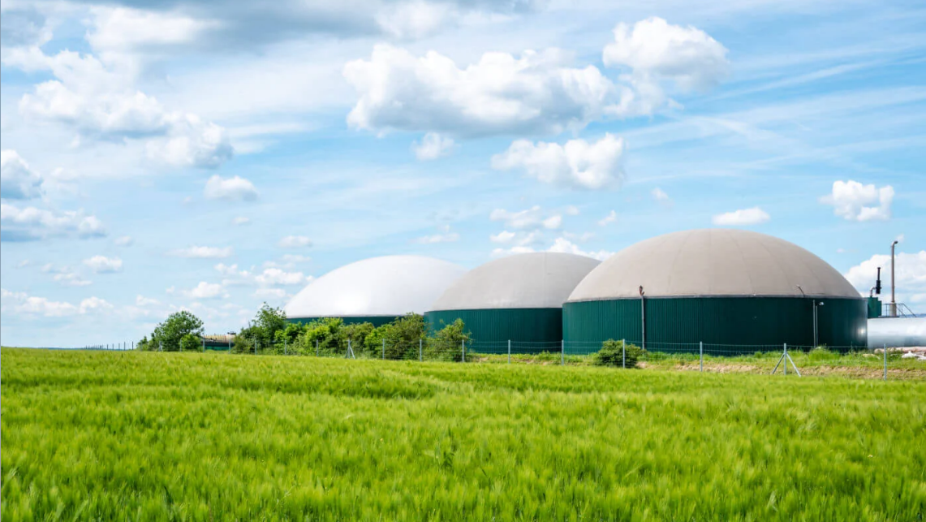
Renewable energy in the transport sector

Slide 10

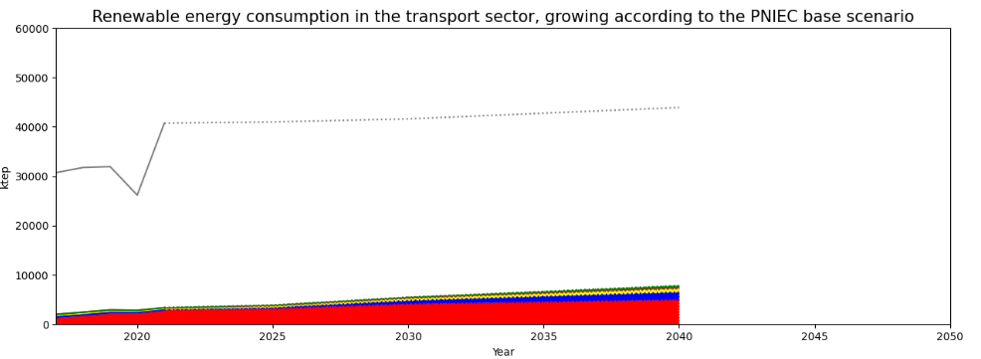
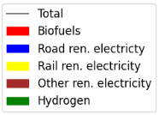
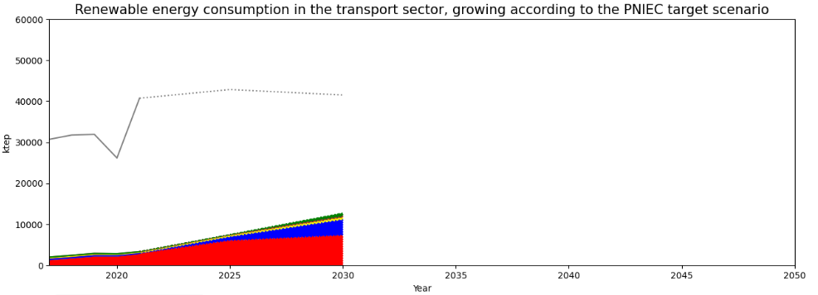
Renewable energy in the transport sector
Baseline scenario
Target scenario

Slide 11
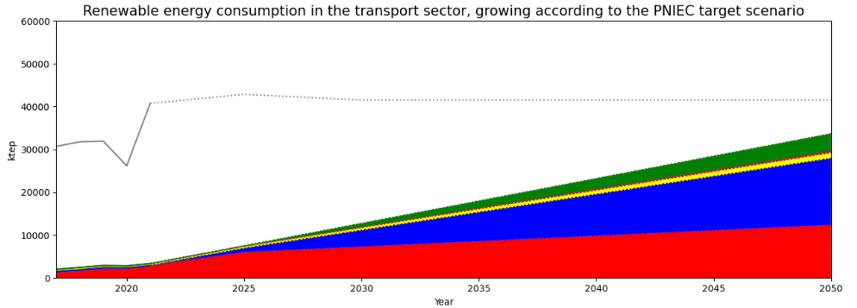
Renewable energy in the transport sector
Projection to 2050

Slide 12
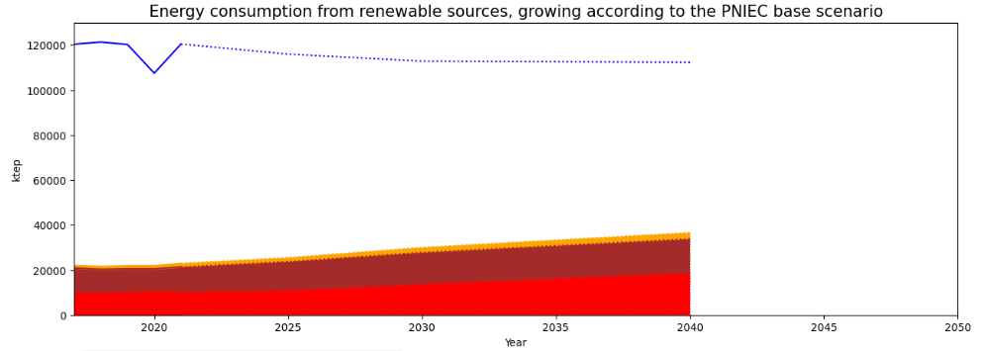
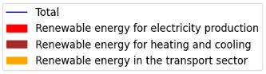
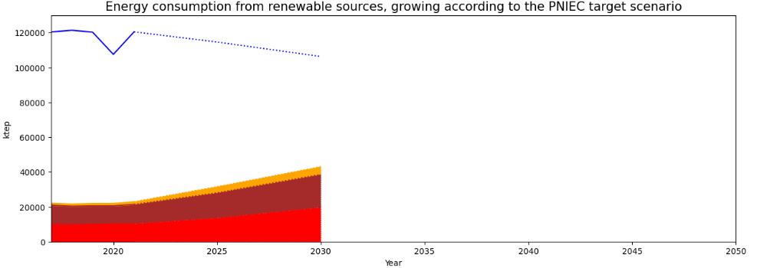
Overall renewable energy in Italy
Baseline scenario
Target scenario

Slide 13
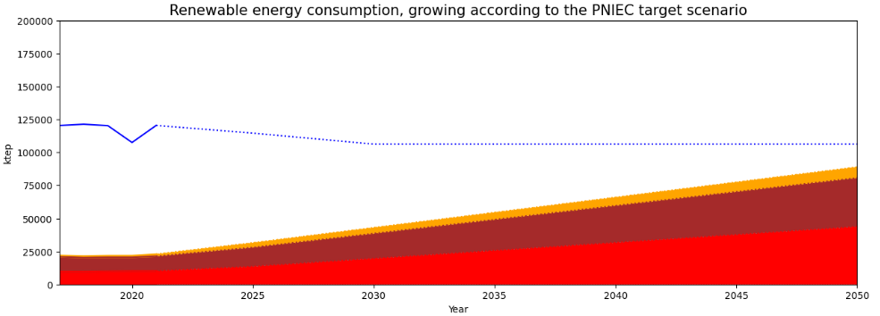
Overall renewable energy in Italy
Projection to 2050

Slide 14
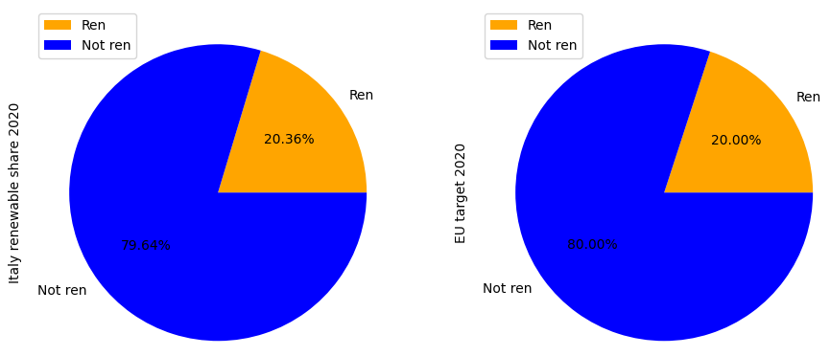
Italian vs European Union targets for 2020

Slide 15
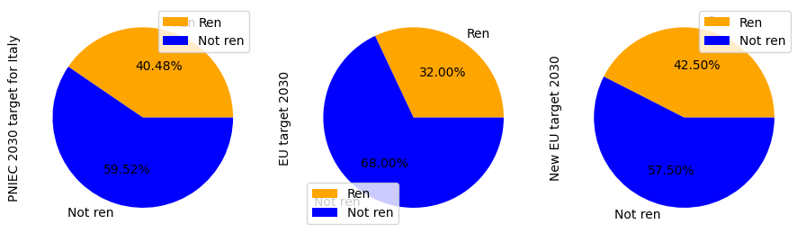
Italian vs European Union targets for 2030

Slide 16
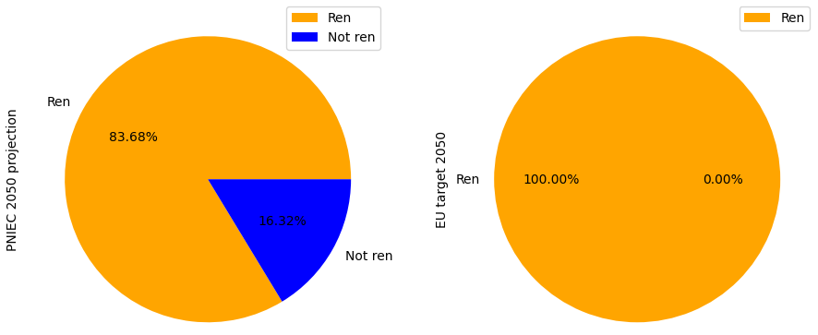
Italian vs European Union targets for 2050

Slide 17
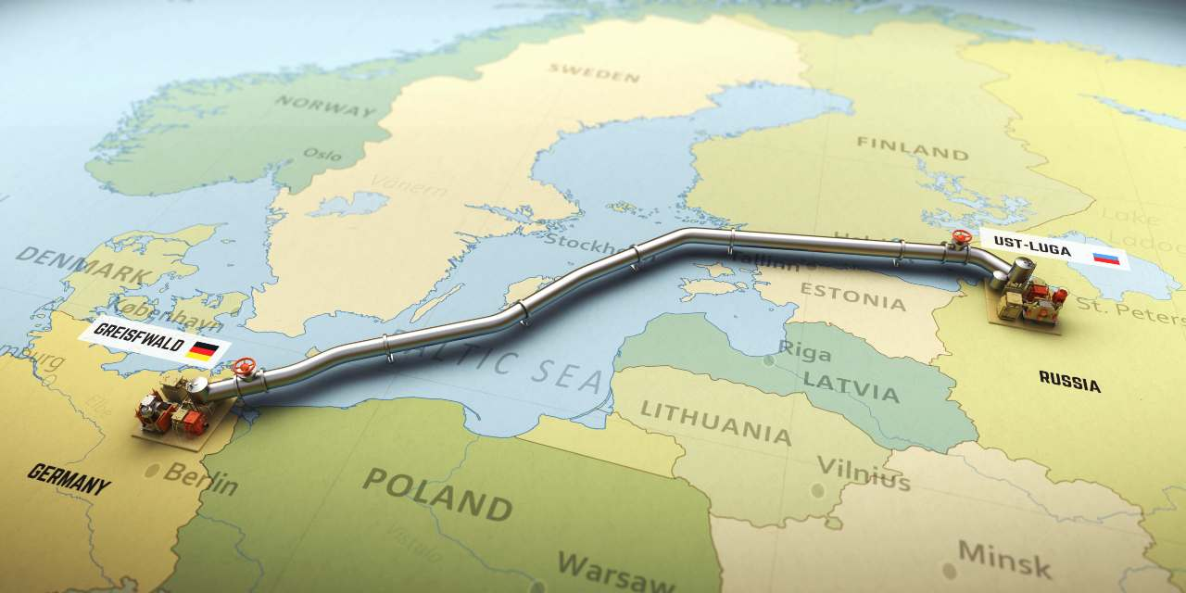
Energy security dimension
How will the russian invasion of Ukraine impact Italy’s energy supplies?

Slide 18
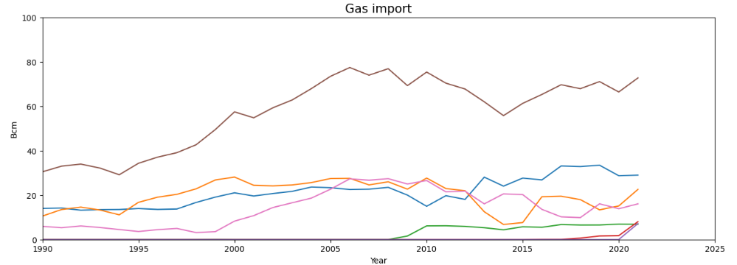
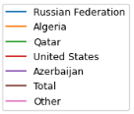
Energy security dimension
Italian gas imports by country, since 1990 (MASE)

Slide 19
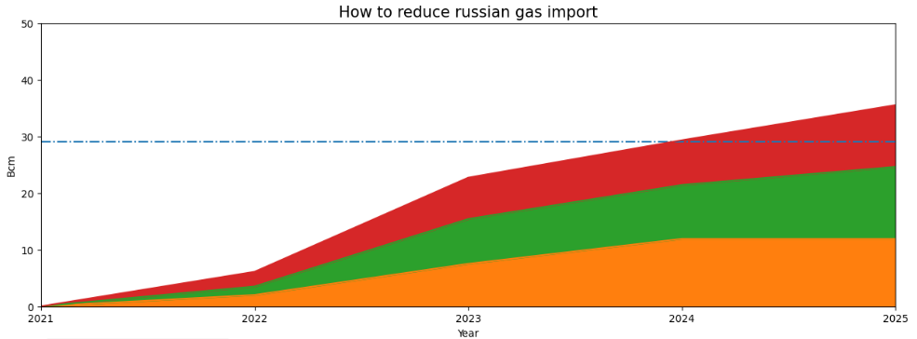
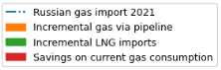
Energy security dimension
Italian strategy to set russian gas import to zero within 2025 (PNIEC)

Slide 20
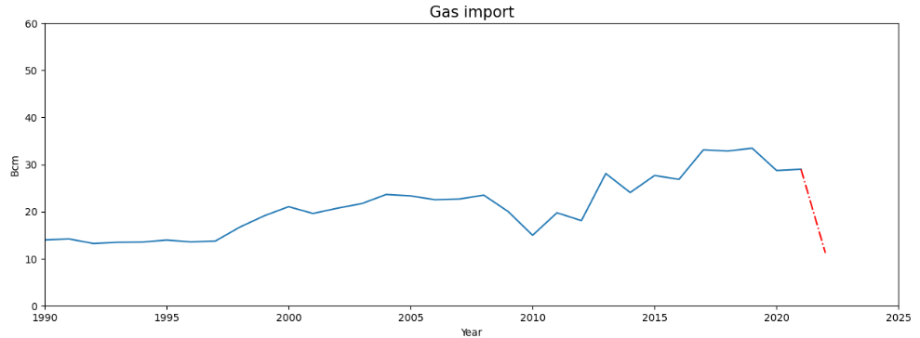
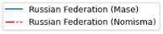
Energy security dimension
Italian gas imports from Russia, since 1990

Slide 21
Conclusions
The Ukraine war has highlighted the strong dependency of the italian energy system from foreign states, which is potentially a serious threat to the energy security of the country.
However, several efforts are being made to replace the imports of russian natural gas in the next few years, and encouraging results have already been achieved in this direction.

Slide 22
Conclusions
Regarding energy sustainability, the 2030 targets for renewable sources proposed by the italian government are mostly aligned with the European Union directives.
In order to reach complete climate neutrality within 2050, however, further efforts will be needed in the next decades.

Slide 23
Sources
https://ourworldindata.org/energy/country/italy
https://www.mase.gov.it/sites/default/files/PNIEC_2023.pdf
https://dgsaie.mise.gov.it/gas_naturale_importazioni.php
https://www.ilsole24ore.com/art/gas-2022-forniture-russia-scese-61percento-AElqjZYC

